Slide 1
Programming of paint robots should be automatic Programming of Paint Robots should not stop the work of the robot Consequenses: Off line or Inline real time or selection of premade programs CAD models or workpieces
InropaTM Idea and vision

Slide 2
InropaTM programming software
Program the robots when they are running
User friendly interface – also for shopfloor personnel
Simulation of Tool motions
Simulation of robot motions
Flexible configuration of Paint Specifications
Easy handling of Paint Jobs for different colours

Slide 3
Use of paint robots among german coating subcontractors
Study 2006
107 subcontractors contacted
73 indicated serious interest in acquiring paint robots
21 had or had had Paint Robots
4 of the 21 had abandoned the robots after shorter usage
Conclusions:
The coating industry is aware, that is has to invest in technology in order to stay efficient.
Investment in robots is often seen in connection with new orders.
Reasons for abandoning robots were linked to programming problems
The running of paint robots demand attention and new ways of thinking

Slide 4
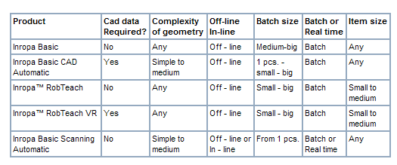
Product Feasibility

Slide 5
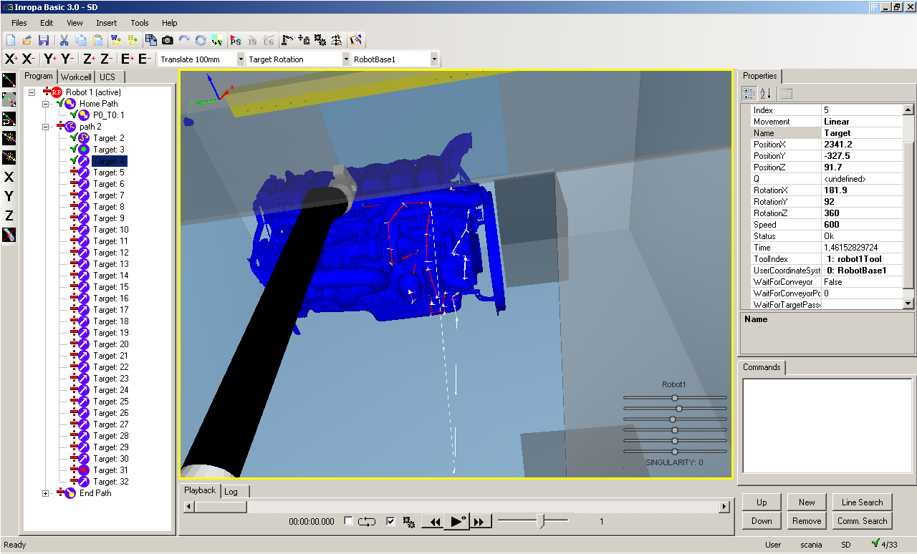

Slide 6
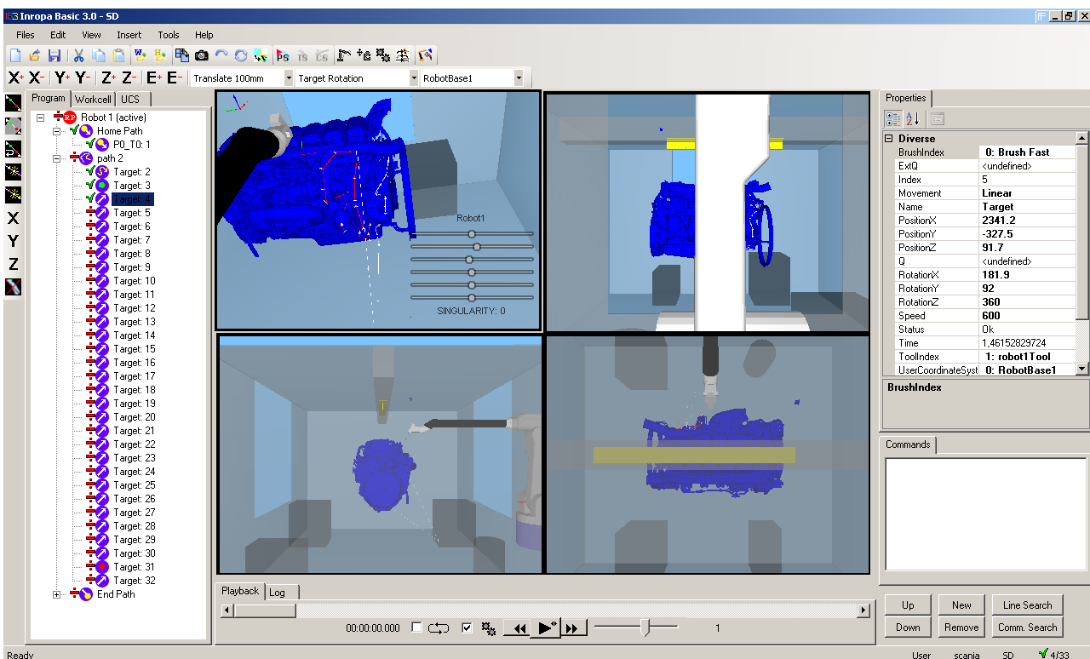

Slide 7
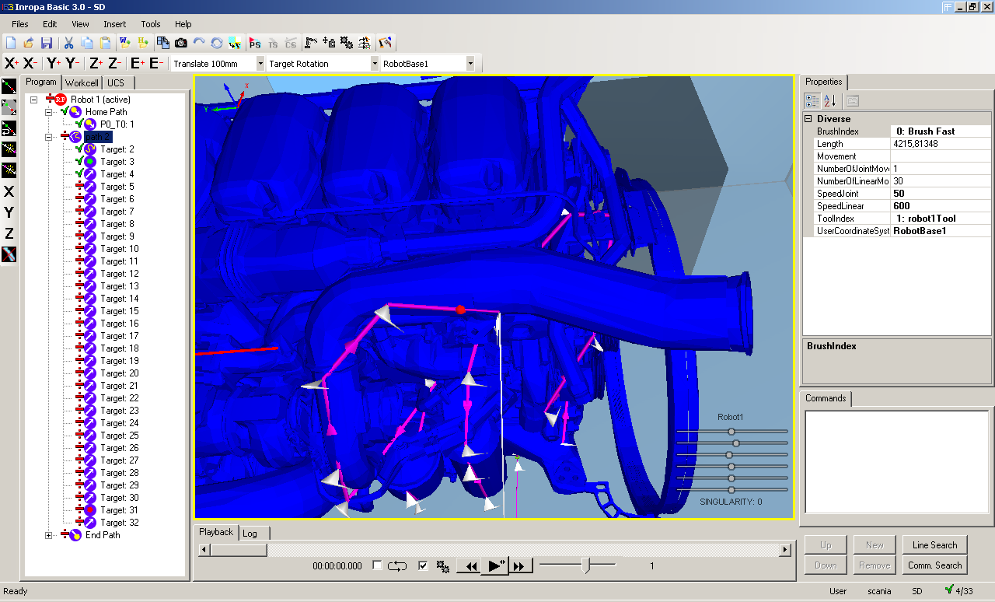

Slide 8
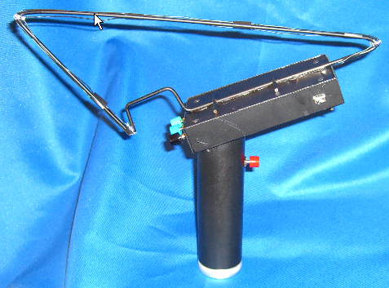
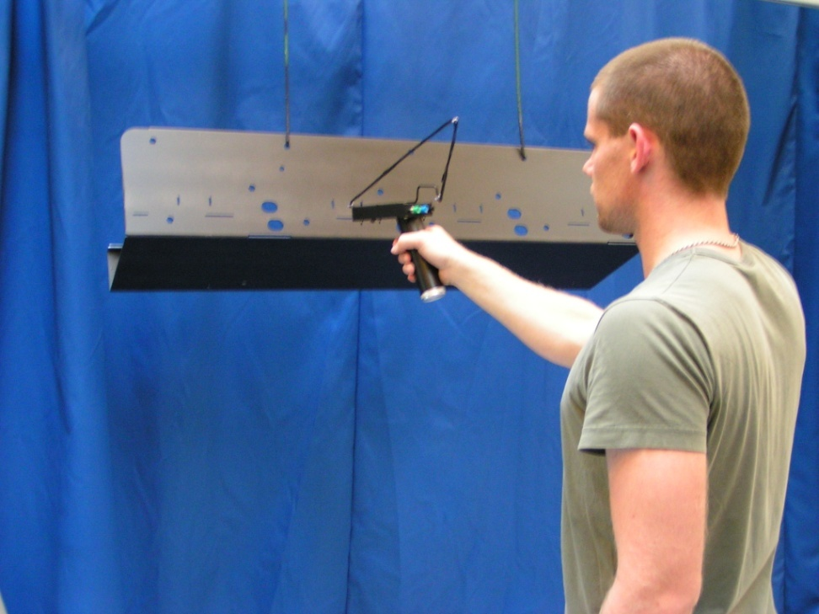
RobTeach
Robot programming method: Off-line
Painting motions are programmed by Virtual paint gun and physical part.
Used for easy teaching of painting motions in medium to large lot sizes.

Slide 9
Inropa Ivision system for parts recognition
Alert
An Alert is very similar to a Rule Definition, except that it triggers an alert, which is evaluated to be true.
This can e.g. be used to assure that certain areas of a part model do indeed contain certain elements.
Rule
A Rule is the heart of the system and what it is all based on. A rule is a vision based approach to
locate a certain feature in an image window.
The following features are supported:
• Width
• Height
• Intensity
• Colour
• Shape – Circle
Each feature is described in detail in the next section.

Slide 10
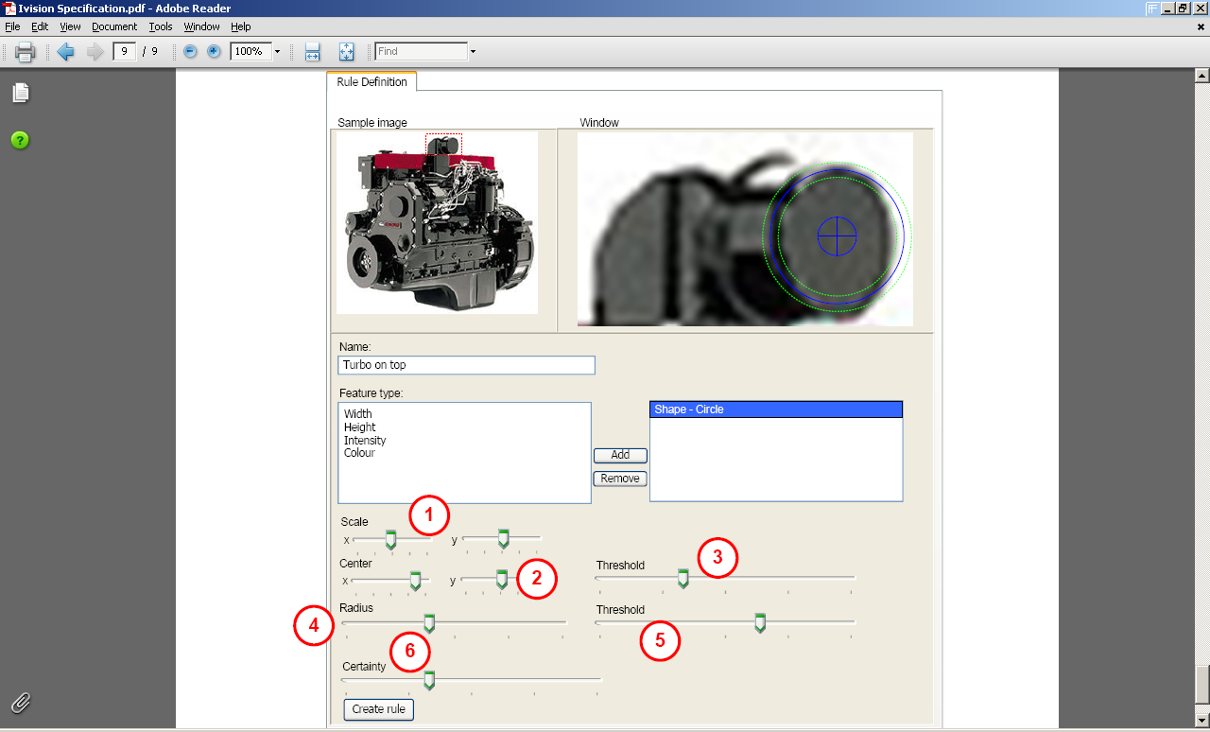

Slide 11
Case: Brandt Industrilakering, Denmark
Application:
Fully automatic High Gloss painting of kitchen elements
Main Constractor:
JHM/Moldow
Robot type:
Fanuc P145

Slide 12
Case: Brandt Industrilakering, Denmark
3D-scanning: In-line
Operator place parts in random position on conveyor
The position and size of parts are scanned automatically
Robot programs are generated on-the-fly using Inropa software

Slide 13
Case: Brandt Industrilakering, Denmark
Fully automated robot programming Robotprogrammering
Produkt variance:
One or more parts on conveyor
Sizes from:
100 x 600 mm
To:
300 x 2000 mm
Simple parts but high gloss quality

Slide 14
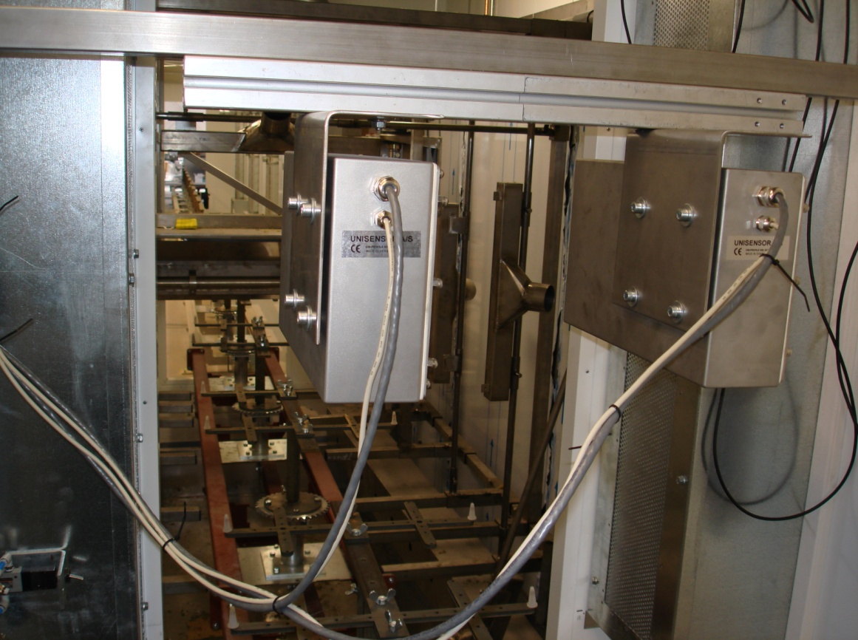
Case: Brandt Industrilakering, Denmark
3D-scanning: In-line
Operator place parts in random position on conveyor
The position and size of parts are scanned automatically
Robot programs are generated on-the-fly using Inropa software

